Slide 1
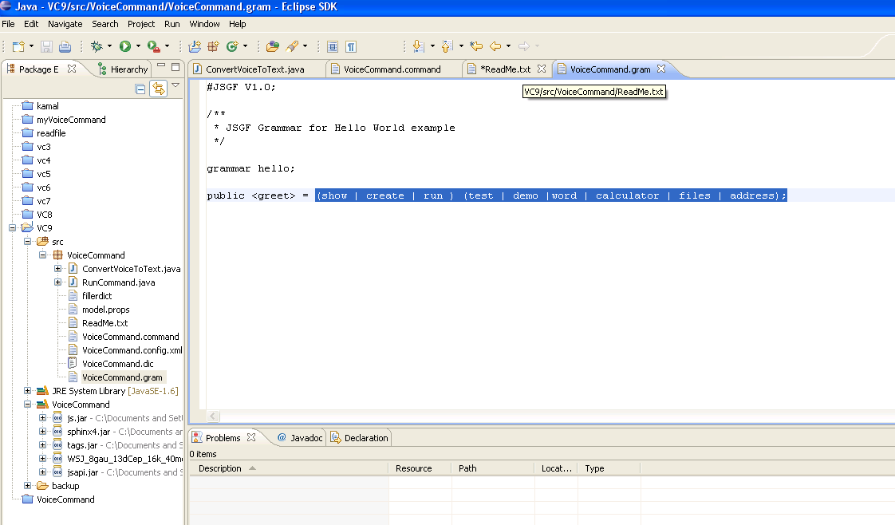

Slide 2
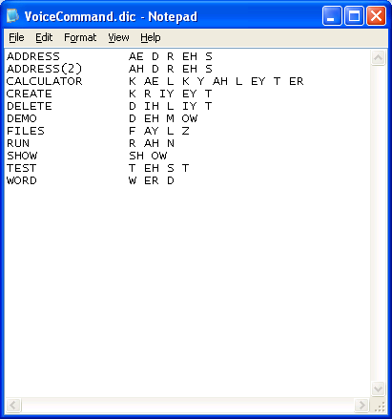

Slide 3
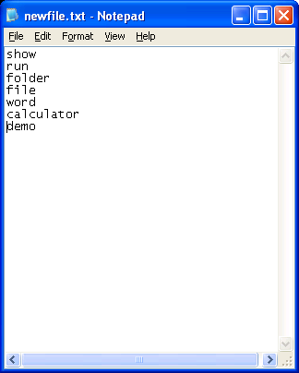

Slide 4
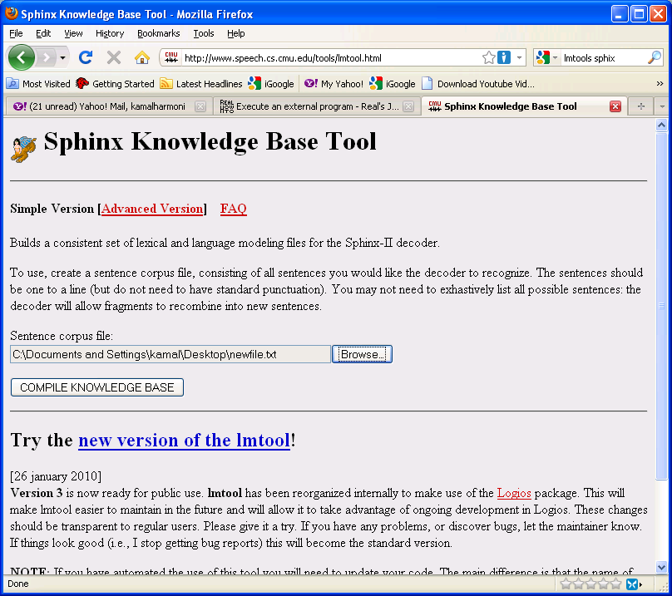

Slide 5
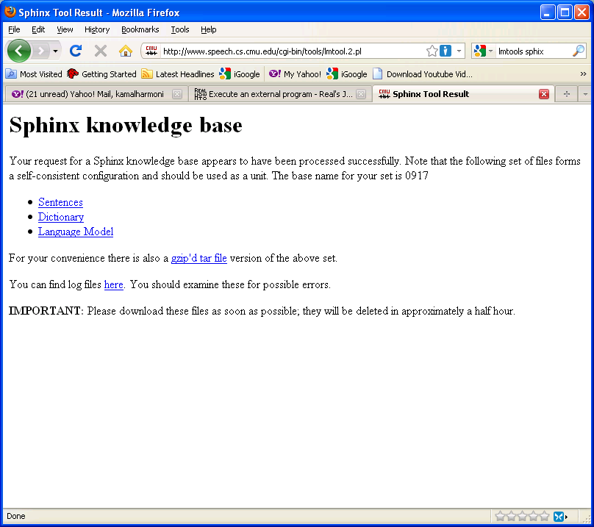

Slide 6
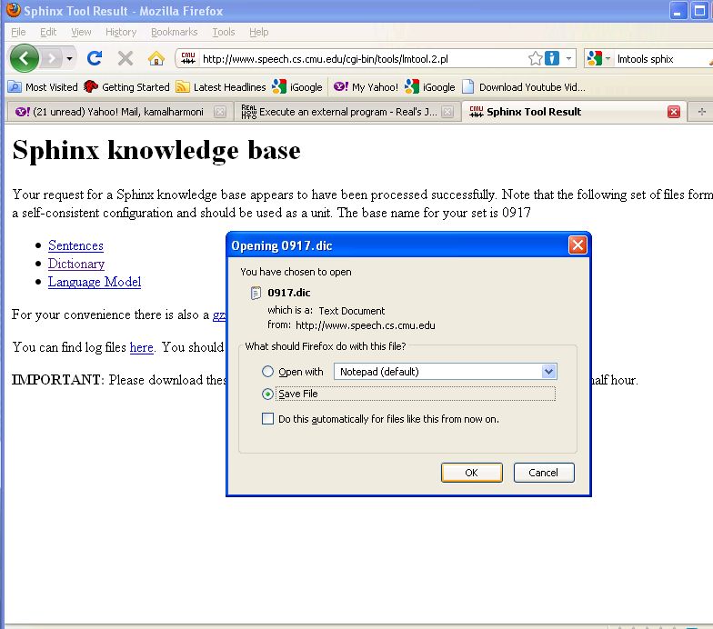

Slide 7
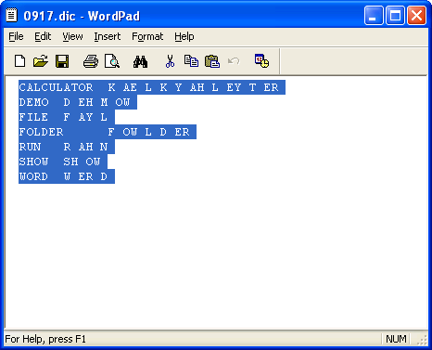

Slide 8
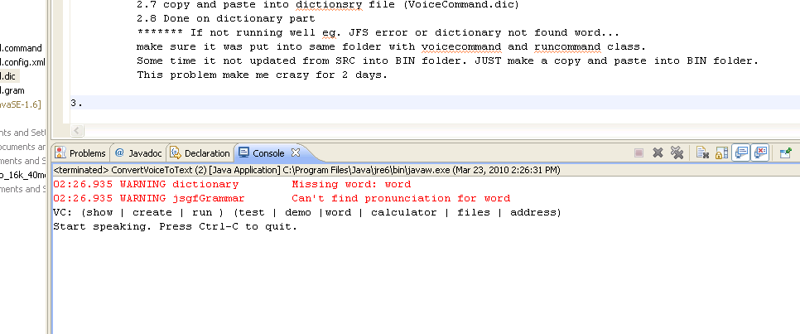
******* If not running well eg. JFS error or dictionary not found word...
make sure it was put into same folder with voicecommand and runcommand class.
Some time it not updated from SRC into BIN folder. JUST make a copy and paste into BIN folder.
This problem make me crazy for 2 days.

